Slide 1
cluster
A00354506 Luis Felipe Sandoval
A00378087 Victor Rodriguez Bahena
A01084687 Jindrizka Dominguez
Cómputo Paralelo y Distribuido
Dr. María Guadalupe Sánchez Cervantes

Slide 2
Introduction
Mainly in parallel: Split problem in smaller tasks that are executed concurrently
Why?
Absolute physical limits of hardware components
Economical reasons – more complex = more expensive
Performance limits – double frequency <> double performance
Large applications – demand too much memory & time
Advantages:
Increasing speed & optimizing resources utilization
Disadvantages:
Complex programming models – difficult development

Slide 3
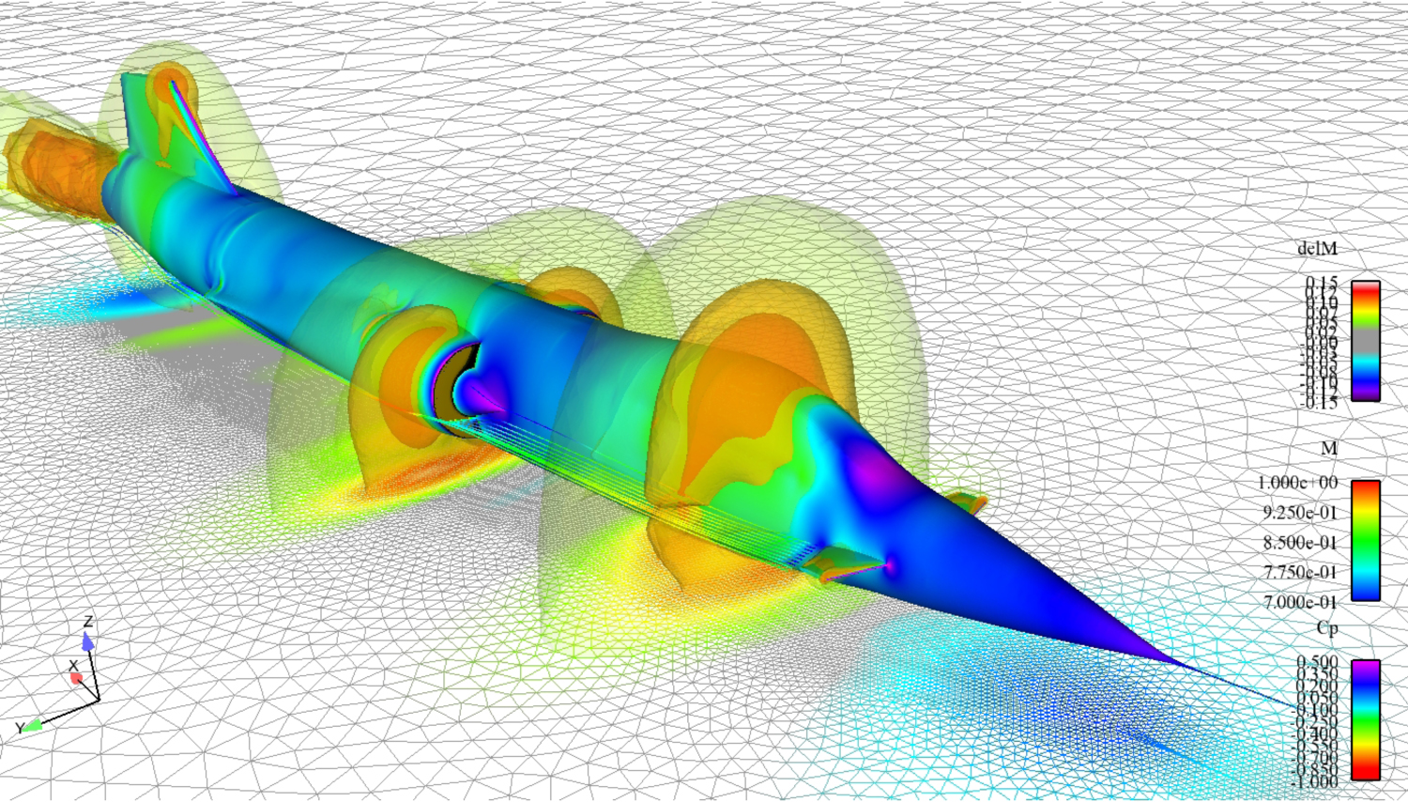
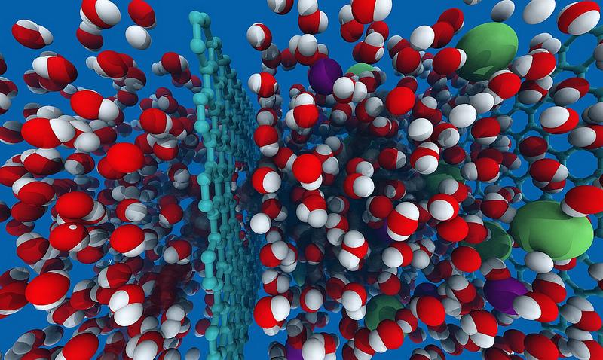
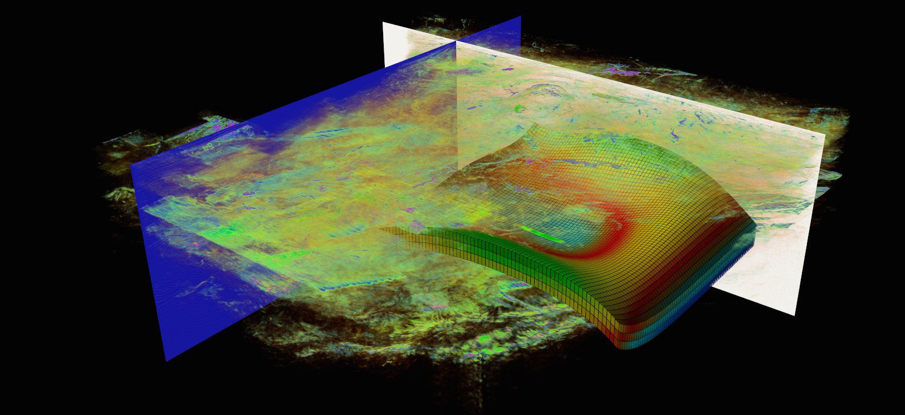
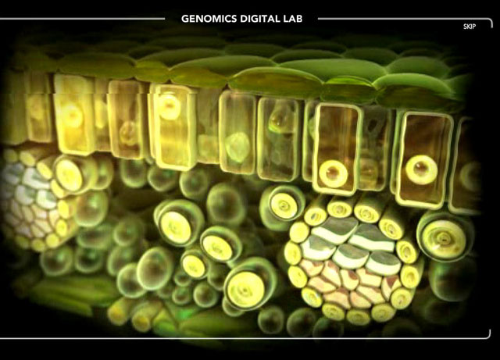
Introduction
Several applications on parallel processing:

Slide 4
Architecture & Trending
Architectures of Parallel Computer:
PVP (Parallel Vector Processor)
SMP (Symmetric Multiprocessor)
MPP (Massively Parallel Processor)
COW (Cluster of Workstation)
DSM (Distributed Shared Memory)

Slide 5
Cluster Computing?
A computer cluster is a group of linked computers, working together closely so that in many respects they form a single computer. The components of a cluster are commonly, but not always, connected to each other through fast local area networks. Clusters are usually deployed to improve performance and/or availability over that provided by a single computer, while typically being much more cost-effective than single computers of comparable speed or availability.

Slide 6
Consists of
Nodes (master+computing)
Network
OS
Cluster middleware: Middleware such as MPI which permits compute clustering programs to be portable to a wide variety of clusters
APP
APP
…
APP
Cluster Middle ware
High Speed Local Network
CPU
CPU
…
CPU
Cluster

Slide 7
Cluster Classification
High availability clusters (HA) (Linux)
Mission critical applications
Network Load balancing clusters
Web servers, mail servers,..
High-availability clusters (also known as Failover Clusters) are implemented for the purpose of improving the availability of services which the cluster provides.
provide redundancy
eliminate single points of failure.
operate by distributing a workload evenly over multiple back end nodes.
Typically the cluster will be configured with multiple redundant load-balancing front ends.
all available servers process requests.
Beowulf
Science Clusters

Slide 8
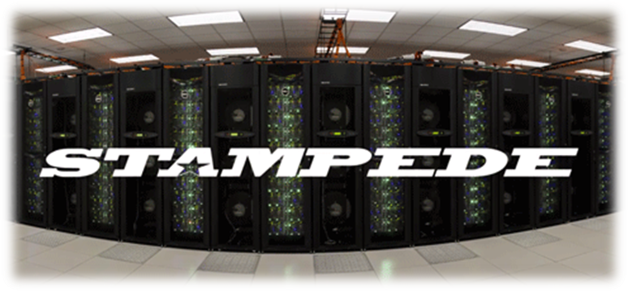





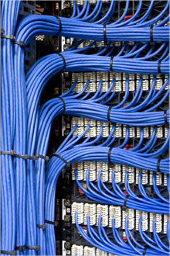
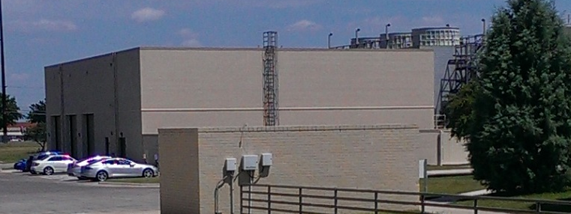

Stampede: Capabilities
OS | Centos6.5
Compute node service | Stateful
Peak Performance | ~9 PF reached = ~2 PF (compute cluster) + ~ 7 PF (coprocessors)
Number of Hosts | ~ 6,600
Number of Intel Xeon Phi Coprocessor | ~ 6,880
Nvidia GPUs | 128
Number of Processing Cores | 522,080
Total Memory | 270 TB
Performance storage system | 14 PB
Distributed storage space | 1.6 PB
InfiniBand ports | ~ 17 k
90%
1.2 million gallon
10%
75 miles
4 M watts
average power usage
96%
Notes:
1 petaflop (PF) = 1 quadrillion math operations per second
XSEDE: virtual system that scientists can use to interactively share computing resources, data and expertise / supports 16 supercomputers and high-end visualization and data analysis resources across the country/ provides the expertise to ensure that researchers can make the most of the supercomputers and tools/
160 compute racks
1.2 million gallon thermal storage tank
75 miles = 120.701 km
Tabla Dell Nodes
6400 Dell PowerEdge C8220 servers, each of which contains dual 8-core Intel Xeon E5-2680 processors and 32 gigabytes of memory
128 next-generation Nvidia GPUs for remote visualization
16 Dell servers with 1 terabyte of shared memory and 2 graphics processing units (GPUs) each for large data analysis
Integrated with the Mellanox FDR 56 Gb/s InfiniBand network for extreme scalability
Tabla Xeon Phi
6,880 special-edition Intel Xeon Phi SE10P co-processors. Stampede is the first large-scale deployment of the new co-processors in the world
The 61-core co-processors use the x86 instruction set and are designed to process highly parallel workloads
The co-processors provide additional performance of 7.4 petaflops

Slide 9
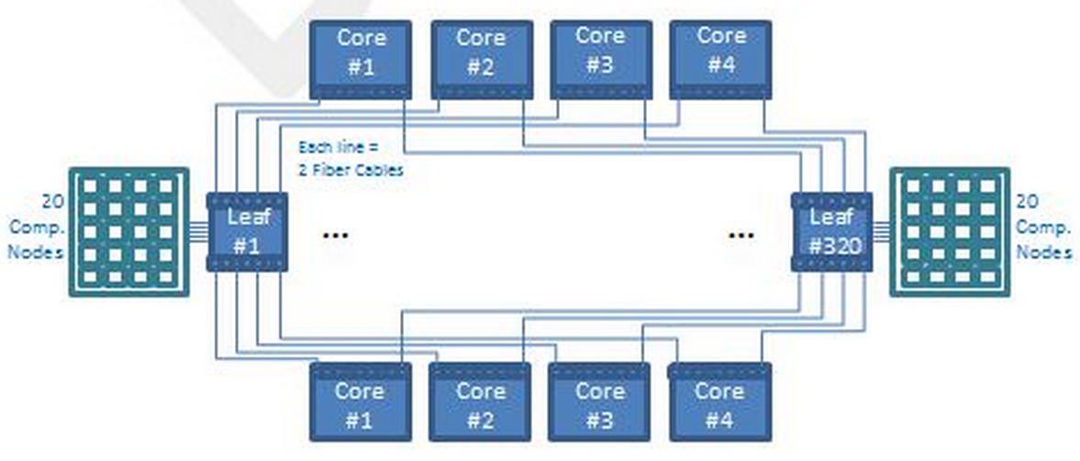
Stampede: Infrastructure
I/O servers offering 14 PB
72 Dell R610 data servers
with Intel® Xeon® processors 5500
and 6 Dell R710 meta data servers
with 2 Dell MD 3220 Storage Arrays
Login Servers
72
I/O Servers
72
I/O Servers
Login Servers
Login Servers
Interconnection
Eight 648-port SX6536 core switches and over 320 36-port SX6025 endpoint
switches (2 in each compute-node rack) form a 2-level Clos fat tree topology
Login Servers
Login Servers
Login Servers
Login Servers
4
Login Servers
Login Servers
4
Metadata S
Login Servers
72
I/O Servers
Master Host
Login servers
Dell PowerEdge R720 with Intel®
Xeon® E5-2600 processors
2 8-core processors and 32GB

Slide 10
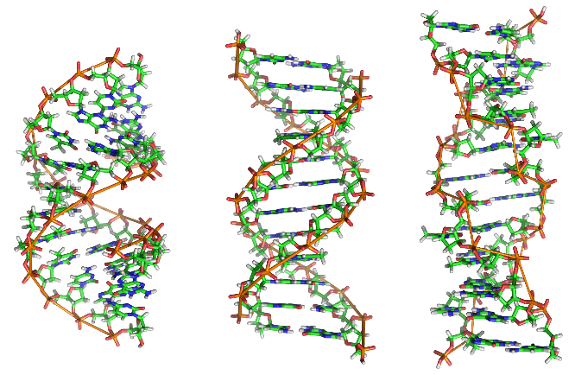
Genetics
and Nucleic Acids →
Physiological and
Genetic Mechanisms Underlying
Salt Tolerance in Rice Across
Developmental Stages

Slide 11

Atomic
Molecular
Optical Physics →
Nonlinear Optical Propagation

Slide 12
Thank you

Slide 13
References
Top500.org
TACC stampede
Wikipedia

